Slide 1
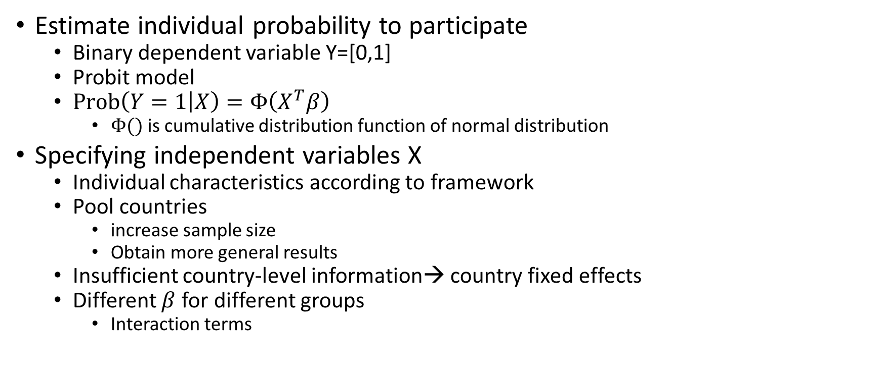
Empirical methodology I
Estimate individual probability to participate
Binary dependent variable Y=[0,1]
Probit model
$\operatorname{Prob}\left(Y=1 | X\right)=Φ\left(X^{T}β\right)$
$Φ()$ is cumulative distribution function of normal distribution
Specifying independent variables X
Individual characteristics according to framework
Pool countries
increase sample size
Obtain more general results
Insufficient country-level information→ country fixed effects
Different $β$ for different groups
Interaction terms

Slide 2
Empirical methodology II
Group by age for life cycle
Young
prime age
old
Group by countries
Low income
Non-low income with low LFPR gap
Non-low income with high LFPR gap
Interact both with all variables

Slide 3
Empirical methodology III
Estimated equation
Age +
Age#CountryGroup#(
prefer to work#(
partnered + acceptable to work + urban + islam)+
education + kids + household members + internet + phone+
women’s opportunity + optimism + poor + challenges) +
Country fixed effects + error term
Use survey weights in estimation
Set sampling strata at country level to adjust standard errors

Slide 4
Empirical methodology IV
Compute average marginal effect
Taking all other variables at actual value
Compute cumulative conditional effect
Compute lowest probability to work by setting variables at respective values
Change values of variables by category to opposite, one category at a time
See conditional marginal effect of categories

